Slide 1
Internet Applications ITA1 Personal website
Presented By : .
Obaid Habib
http://athena.fhict.nl/users/i281301/

Slide 2
Subject
My web site based on my personal information and about my educational skills .
Next i added some information about my country .
Because I introduced myself as an ICT person so I added little information about new releases in computer and mobile world .

Slide 3
Goals
Main purpose of my website is to share my information with other people .
And second goal was to introduced my country .
My targeted audience was students and professionals as well .
I introduced my self as an ICT person so with my information I added some information…

Slide 4
Goals Con….
About new technologies(new releases) to tell my audience (students) that these are some interest areas of a ICT person .
I also mentioned about my skills if some one want me to work with him /her on certain project and they think that my skills are good enough to work with them they can contact me any time I have mentioned my contact details in contact page .

Slide 5
INFORMATION
Through this website I have shared my personal information such as who I am , where I came from , what I have done in my life(educational carrier) and what I am doing .
Next I shared my skills information that what I have learned so far .
After that I showed love to for my country that I can never forget you I have added short history and about tourism in Kashmir.

Slide 6
Information con…
After that I shared some information about new technologies(new releases) with my audience main purpose of that information is to show my interest areas as an Ict person and to keep an eye on computer and mobile world.

Slide 7
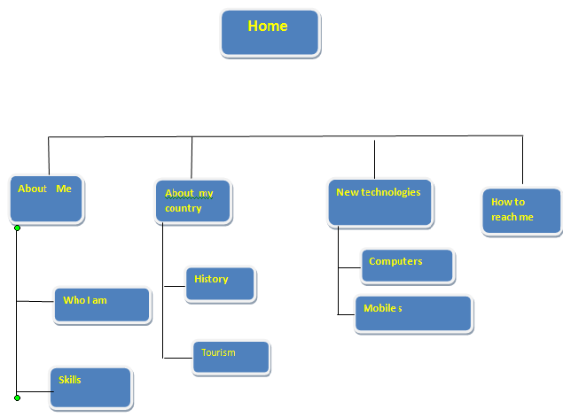
Navigation structure

Slide 8

Home

Slide 9
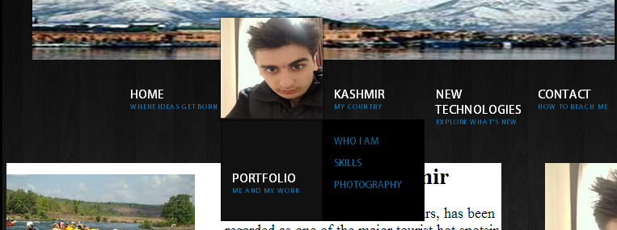
Protofolio

Slide 10

kashmir

Slide 11
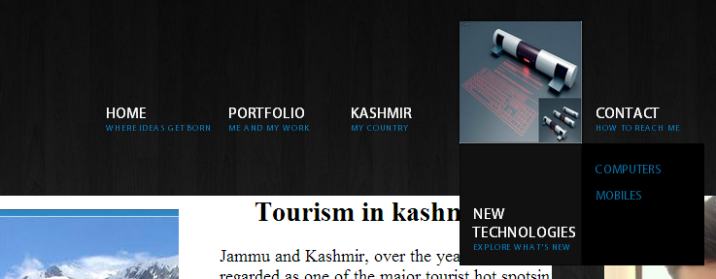
New technologies

Slide 12
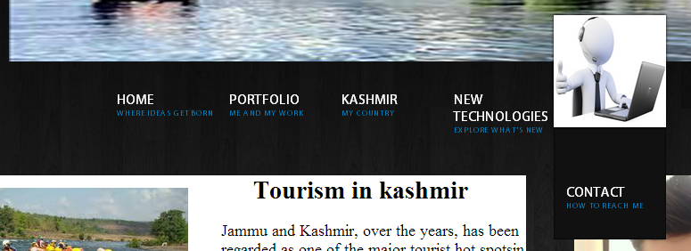
Contact

Slide 13
Conclusion
My target was to represent myself my skills and to share some new information or news with my audience that represents my interest areas .
I have success fully achieved all of my targets regarding this website .

Slide 14


